Slide 1
Foundations of
Generative AI
LLMs
Session 1 — GenAI Cohort
Saksham Arora
Software Engineer II @ Intuit
Ex - Software Engineer @ Microsoft
https://www.linkedin.com/in/sakshamarora9575/

Slide 2
Before We Start — The Mental Model
We're going to add a new primitive.
No prior AI/ML background required.
You open your laptop, type a problem you’ve been stuck on, and hit Enter.
Almost instantly, the AI replies with working code, a clean explanation, and even suggestions you hadn’t considered.
For a moment, it feels like there’s another engineer helping you think. But there isn’t. There’s no understanding of the problem, no awareness of the goal, no real “thinking” happening at all. So how can something that doesn’t understand anything still be so useful - and sometimes so convincing?

Slide 3
What Is Generative AI?
AI that produces new content — text, code, images, audio, video —
rather than just classifying or predicting from existing options.
Discriminative models
• Given an email, is it spam? (P(class | input))
• Output space is small and known
Generative models
• Given a prompt, produce a plausible continuation. P(next | history)
• Output space is open-ended (any string of tokens)
This course focuses on text/code-generating models — LLMs.
Same architecture family powers Sora, MusicGen, etc.

Slide 4

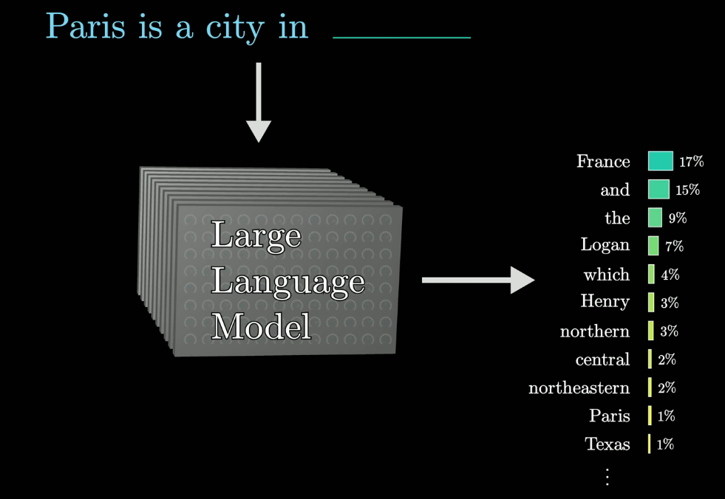
LLM
LLMs (Large Language Models) are powerful AI programs that learn from huge amounts of text so they can understand and generate human-like language.

Slide 5
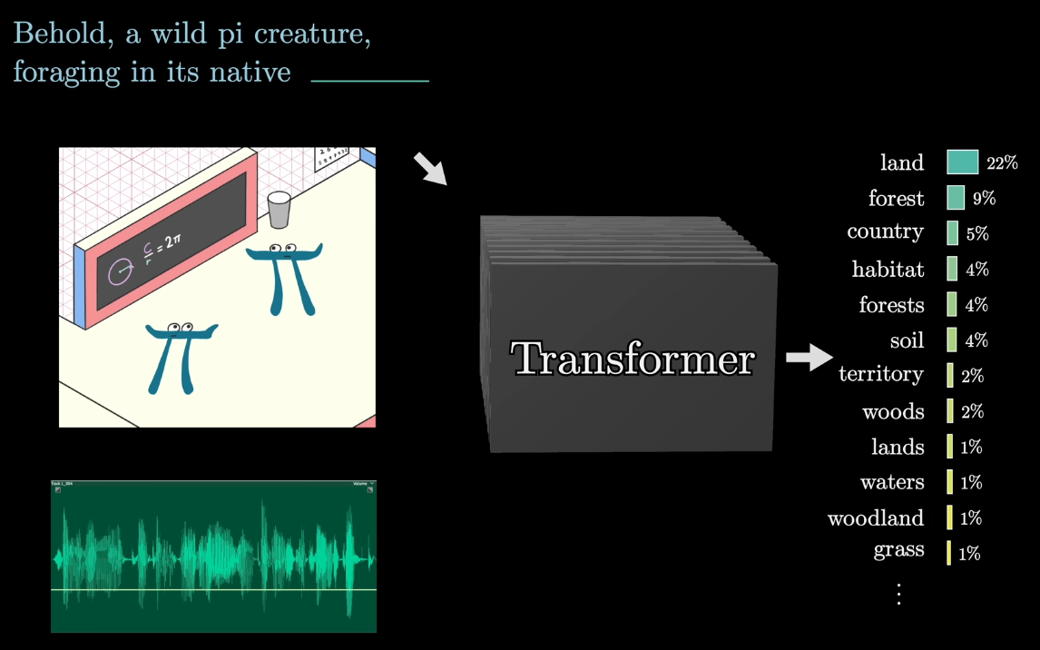

Slide 6
Anatomy of an LLM
Think of a large language model like a very big, very fast autocomplete system.
You give it some text, and it tries to guess what comes next — one piece (token) at a time.
Simple flow:
Your text → turned into numbers (tokens)
Those numbers → turned into vectors (embeddings)
Passed through many layers (transformer blocks)
Output → probabilities for the next word/token
It picks one → and repeats
Each layer does three main things:
Attention: Every word looks at all the other words to understand context (e.g., “bank” near “river” vs “money”)
Processing (FFN): Each word is transformed individually to refine its meaning
Stability helpers: Small tweaks (residuals + normalization) keep learning stable

Slide 7
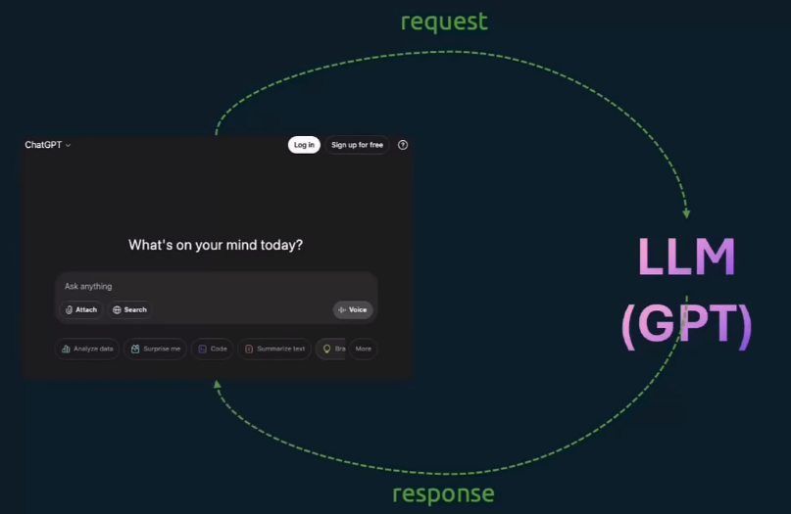
How prompting works ?

Slide 8
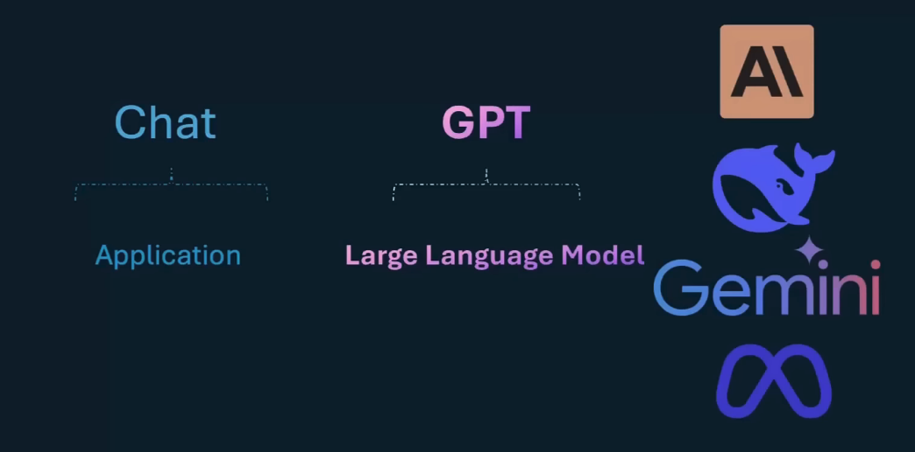
Famous LLMs

Slide 9
Tokens — The Atomic Unit
LLMs don't see characters or words. They see tokens.
A token is a sub-word chunk learned by a tokenizer.
• "engineering" → ["engineer", "ing"]
• "supercalifragilistic" → ["super", "cal", "if", "rag", "ilist", "ic"]
• Common words = 1 token, rare words = many tokens
Why this matters:
• Cost is per-token (input + output) — not per character or per call
• Context window is in tokens — ~4 chars/token for English, less for code/non-English
**Rule of thumb:** 1000 tokens ≈ 750 English words ≈ 4KB of text.
Try it: platform.openai.com/tokenizer or tiktoken Python library.

Slide 10
How LLMs Are Trained — Three Stages
1. Pretraining
2. Supervised Fine-Tuning (SFT)
3. Preference Tuning
The model reads huge amounts of text (internet, books, code)
Its job is simple:
guess the next word/token
How it learns
No humans labeling data
The “correct answer” is just the next word in the text
This is called self-learning from data
Cost
Extremely expensive:
$10M–$100M+
Runs for weeks on thousands of GPUs
From this we get BASE MODEL
Preference training (simple explanation)
Humans are shown two answers from the model
They pick which one is better
This teaches the system what people prefer
Then what happens?
A separate model learns: “what kind of answers humans like” (reward model)
The main LLM is trained to give more of those good answers
This is what made ChatGPT feel different from GPT-3
— not just completing text, but actually responding like a helpful assistant.
The model is trained on good examples made by humans:
An instruction (question/task)
A high-quality answer
What does it learn?
It learns how to respond properly, like:
Answer questions clearly
Follow instructions
Refuse unsafe or harmful requests
Why it’s useful
Teaches the model the right style and format of answers

Slide 11
What Modern LLMs Are Genuinely Good At
Strong
Surprisingly Weak (without help)
• Summarization & rewriting
• Translation, tone shifts
• Code generation & review
• Structured extraction (JSON,
classification, NER)
• Following long, detailed
instructions
• Tool/function calling
• Multi-step planning when
scaffolded properly
• Exact arithmetic on long
numbers
• Counting characters/items
in their own output
• Up-to-date facts
• Anything specific to your
company's data
• Citing real sources (will
fabricate URLs/cases)
• Self-knowing when wrong

Slide 12
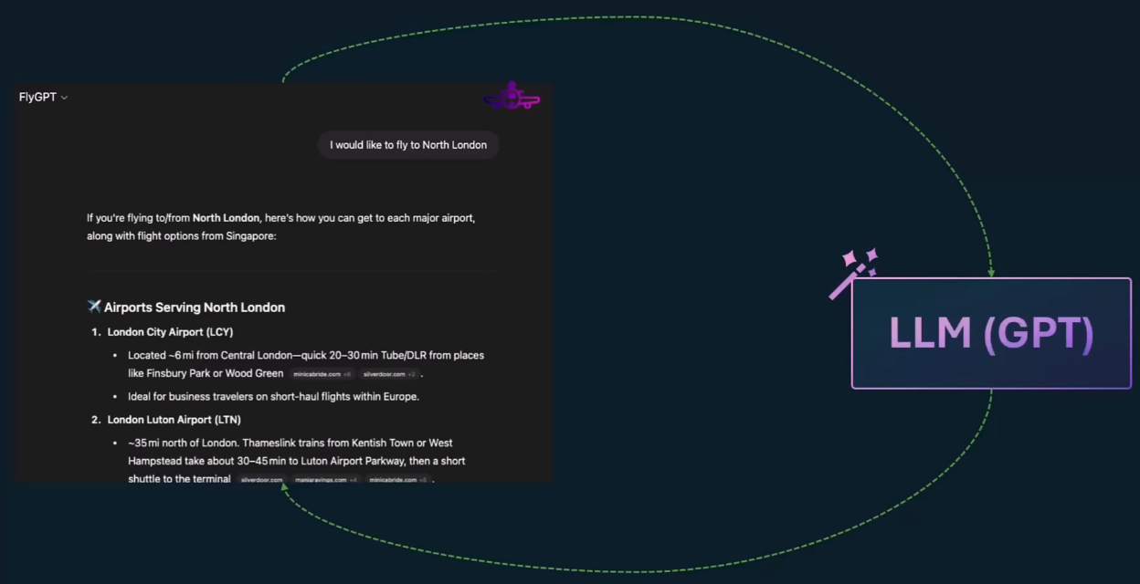
FlyGPT

Slide 13
Limitations of LLMs — The Six You'll Hit in Production
① Hallucination — confident, fluent, wrong
② Knowledge cutoff — frozen at training date
③ No access to private data — doesn't know your DB, your repo, your users
④ Bounded context window — finite room for input + output
⑤ Reasoning gaps — math, logic, multi-hop deduction
⑥ Cost & latency — every token has a price and a delay
Each limitation maps to a technique we'll cover this cohort:
RAG, tools, prompt design, agents, evals.

Slide 14
Limitation 1 — Hallucination
LLMs generate plausible-sounding text. Plausible ≠ true.
Why it happens — mechanically:
• Training objective rewards likely tokens, not true tokens
• No grounding signal at inference unless you provide one
• Model has no reliable internal 'I don't know' calibration
Real failure modes engineers see:
• Invented function names from a real library ("torch.optim.AdamWithMagic")
• Fake legal cases / DOIs / RFC numbers
• Confidently wrong API signatures, especially for newer libs

Slide 15
Limitation 2 — Knowledge Cutoff
Every model has a training cutoff date. After that, it knows nothing.
What it doesn't know:
• Yesterday's stock price, today's incident, last week's PR merge
• New library versions, breaking changes, deprecated APIs
• Your company's documents, ever
Common engineer trap:
• Asking for code using a library released after the cutoff
• Model will happily invent an API that 'looks right'
Even 'live' models like GPT-4o + browsing are RAG under the hood —
they retrieve and inject context before generating.

Slide 16
Limitation 3 — The Context Window
The context window is the max number of tokens the model can attend to at once.
Today's ranges (input + output combined):
• GPT-4o: 128K • Claude 3.5/4: 200K • Gemini 1.5/2: 1M–2M • Llama 3.1: 128K
Why 'just stuff everything in' doesn't work:
• Cost — you pay per token, every call
• Latency — attention is roughly O(n²) in sequence length
This is why we don't paste the whole codebase — we retrieve relevant chunks.
Retrieval is cheaper, faster, and more accurate than 'long context everything'.

Slide 17
Limitations 4–6 — Private Data, Reasoning, Cost
4. No access to private data
• The model has never seen your repo, your tickets, your users' data
• RAG is the more practical default — fresh, auditable, cheaper
5. Reasoning gaps
• Multi-step math, formal logic, large state-space planning
• Mitigations: chain-of-thought / 'thinking', tool use (calculator, code interpreter),
decomposition into smaller steps, agentic loops with verification
6. Cost & latency
• Input ~$1–15 / 1M tokens, output ~$3–75 / 1M (varies wildly by model)
• First-token latency 0.3–2s, full response can be 10s+ for long output
• Levers: smaller models for easy hops, prompt caching, batching
Most production GenAI work is *engineering around these limitations*.

Slide 18
How Do We Fix These?
Technique | Changes | Best for | Cost
Prompt engineering | What you ask | Behavior, format, tone | Free, instant
RAG | What the model sees | Fresh / private / large data | Low–medium
Tool use / function calling | What the model can do | Actions, math, real-time data | Low–medium
Fine-tuning | The model itself | Stable style, niche tasks | High, slow
Agents / orchestration | How calls compose | Multi-step workflows | Medium–high
Default ladder: Prompt → RAG/tools → Agent loop → Fine-tune (only when the rest plateaus).

Slide 19
Embeddings
An embedding is just a way to turn text into a list of numbers
→ so a model can understand meaning
What it looks like
Any sentence → becomes a fixed-size vector (list of numbers)
Example:
“Reset my password” → one vector
“How do I change my login credentials?” → very similar vector
“What time is the meeting?” → very different vector
Key idea
Similar meaning = similar numbers
Even if the words are different, the vectors can still be close.
Cool example (idea)
king − man + woman ≈ queen
The model captures relationships between meanings

Slide 20
Embedding Models — The Landscape
Model | Provider | Dim | Notes
text-embedding-3-large | OpenAI | 3072 | Highest quality, configurable dims
text-embedding-3-small | OpenAI | 1536 | Cheap, surprisingly strong
voyage-3 / voyage-code-3 | Voyage AI | 1024 | Top of MTEB; code-tuned variant
embed-v4 | Cohere | 1024 | Multilingual, strong recall
bge-large-en-v1.5 | BAAI (open-source) | 1024 | Self-host, GPU friendly
all-MiniLM-L6-v2 | Sentence Transformers | 384 | Tiny, runs on CPU, prototyping
Pick by: quality (MTEB leaderboard), cost, latency, dimension (storage), and self-host vs API.

Slide 21
Tools
Cursor https://cursor.com/download
Antigravity https://antigravity.google/
Windsurf https://windsurf.com/
Qoder https://qoder.com/
VS Code + Claude (If you have PAID version)

Slide 22
Questions?
Today's foundations → next session we get our hands dirty with prompts.
Saksham Arora • Software Engineer II @ Intuit
https://www.linkedin.com/in/sakshamarora9575/

